Slide 1
ERD to Tables
Tables to Normalized Tables

Slide 2
Null Values
We must allow for missing or incomplete information by allowing null values as place holders for non-null constants.
E.g. An Employee’s address is unknown.
E.g. An Employee’s spouse does not exist.
The special place holder null will be used as a null value.

Slide 3
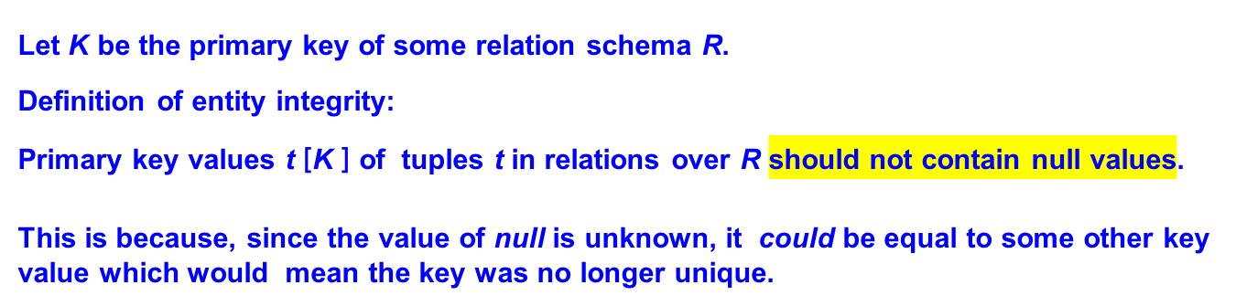
First Fundamental Integrity Constraint (of the relational model)

Slide 4
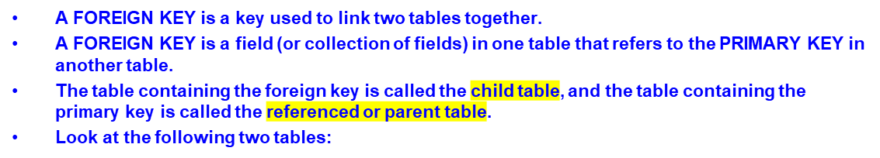
Foreign Key
"Persons" table:
PersonID | LastName | FirstName | Age
1 | Hansen | Ola | 30
2 | Svendson | Tove | 23
3 | Pettersen | Kari | 20
The "PersonID" column in the "Persons" table is the PRIMARY KEY in the "Persons" table.
The "PersonID" column in the "Orders" table is a FOREIGN KEY in the "Orders" table.
The FOREIGN KEY constraint is used to prevent actions that would destroy links between tables.
The FOREIGN KEY constraint also prevents invalid data from being inserted into the foreign key column, because it has to be one of the values contained in the table it points to.
"Orders" table:
OrderID | OrderNumber | PersonID
1 | 77895 | 3
2 | 44678 | 3
3 | 22456 | 2
4 | 24562 | 1
FOREIGN KEY constraints enforce referential integrity: if “PersonID” is foreign key in “Orders” table, then the “PersonID” is “Persons” table must exist.

Slide 5
Normalization
This is the process which allows you to remove redundant data within your database.
A properly normalized database should have the following characteristics
  Scalar values in each fields
  Absence of redundancy.
  Minimal use of null values.
  Minimal loss of information.

Slide 6
Levels of Normalization
Various levels of normalization are:
  First Normal Form (1NF)
  Second Normal Form (2NF)
  Third Normal Form (3NF)
  Boyce-Codd Normal Form (BCNF)
  Fourth Normal Form (4NF)
  Fifth Normal Form (5NF)
  Domain Key Normal Form (DKNF)
Most databases should be 3NF or BCNF in order to avoid the database anomalies.

Slide 7
Levels of Normalization
1NF
2NF
3NF
4NF
5NF
DKNF

Slide 8
First Normal Form (1NF)
A table is considered to be in 1NF if all the fields contain
only scalar values (non-multi-values).
Example (Not 1NF)
ISBN
Title
AuName
AuPhone
PubName
PubPhone
Price
0-321-32132-1
Balloon
Sleepy, Snoopy, Grumpy
321-321-1111, 232-234-1234, 665-235-6532
Small House
714-000-0000
$34.00
0-55-123456-9
Main Street
Jones, Smith
123-333-3333, 654-223-3455
Small House
714-000-0000
$22.95
0-123-45678-0
Ulysses
Joyce
666-666-6666
Alpha Press
999-999-9999
$34.00
1-22-233700-0
Visual Basic
Roman
444-444-4444
Big House
123-456-7890
$25.00
AuName and AuPhone columns are not scalar
Notes:
Having scalar values also means that all instances of a record type must contain the same number of fields.
A table not in first normal form is called un normalized

Slide 9
1NF - Decomposition
Place all items that appear in the repeating group in a new table
Duplicate in the new table the primary key of the table from which the repeating group was extracted or vice versa.
Example (1NF)
ISBN
AuName
AuPhone
0-321-32132-1
Sleepy
321-321-1111
ISBN
Title
PubName
PubPhone
Price
0-321-32132-1
Snoopy
232-234-1234
0-321-32132-1
Balloon
Small House
714-000-0000
$34.00
0-321-32132-1
Grumpy
665-235-6532
0-55-123456-9
Main Street
Small House
714-000-0000
$22.95
0-55-123456-9
Jones
123-333-3333
0-123-45678-0
Ulysses
Alpha Press
999-999-9999
$34.00
0-55-123456-9
Smith
654-223-3455
1-22-233700-0
Visual Basic
Big House
123-456-7890
$25.00
0-123-45678-0
Joyce
666-666-6666
1-22-233700-0
Roman
444-444-4444
Notes:
1. The designated key will be the primary key of the original table concatenated with one or more data items from the new table.
For the first table the primary key is ISBN
For the second table the primary key is ISBN + Author Name

Slide 10
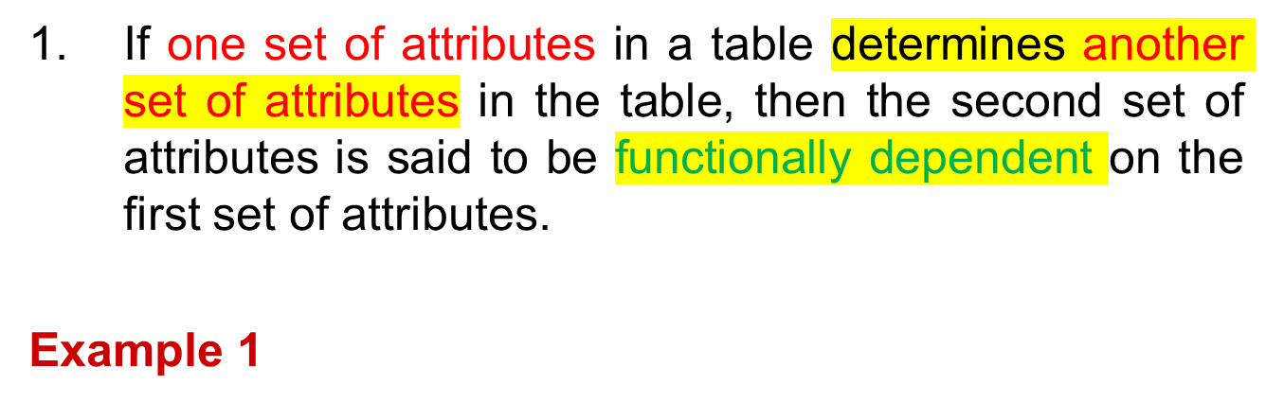
Functional Dependencies
ISBN
Title
Price
Table : {ISBN, Title, Price}
Functional Dependencies: {ISBN} → {Title}
{ISBN} → {Price}
0-321-32132-1
Balloon
$34.00
0-55-123456-9
Main Street
$22.95
0-123-45678-0
Ulysses
$34.00
1-22-233700-0
Visual Basic
$25.00
Notes:
Notes to Instructor: Need more rigor in the functional dependencies. With a few examples. May be create a class assignment for functional dependencies.

Slide 11
Second Normal Form (2NF)
For a table to be in 2NF, there are two requirements
  The database is in first normal form
  All nonkey attributes in the table must be functionally dependent on the entire primary key
Note: Remember that we are dealing with non-key attributes
Example 1 (Not 2NF)
Scheme → {Title, PubId, AuId, Price, AuAddress}
  Key → {Title, PubId, AuId}
  {Title, PubId, AuID} → {Price}
  {AuID} → {AuAddress}
  AuAddress functionally depends on AuId which is a subset of a key and not the entire primary key

Slide 12
Second Normal Form (2NF)
Example 2 (Not 2NF)
Scheme → {City, Street, HouseNumber, HouseColor, CityPopulation}
  key → {City, Street, HouseNumber}
  {City, Street, HouseNumber} → {HouseColor}
  {City} → {CityPopulation}
  CityPopulation is a nonkey attribute
  CityPopulation is functionally dependent on the City which is a subset of a key and not the entire primary key
Example 3 (Not 2NF)
Scheme → {studio, movie, budget, studio_city}
  Key → {studio, movie}
  {studio, movie} → {budget}
  {studio} → {studio_city}
  studio_city is a nonkey attribute
  studio_city functionally depends on studio which is a subset of a key and not the entire primary key
Notes:
Let us consider the problems with the movie studio database:
Redundancy – City Population is repeated many times
Insertion anomaly – Whenever we add a new record we have to add unnecessary information. We can not add record until we know information about the city population
Deletion anomaly – Whenever we delete a record, useful information is deleted.
Update anomaly – The City Population needs to be updated in more than one location if it changes.

Slide 13
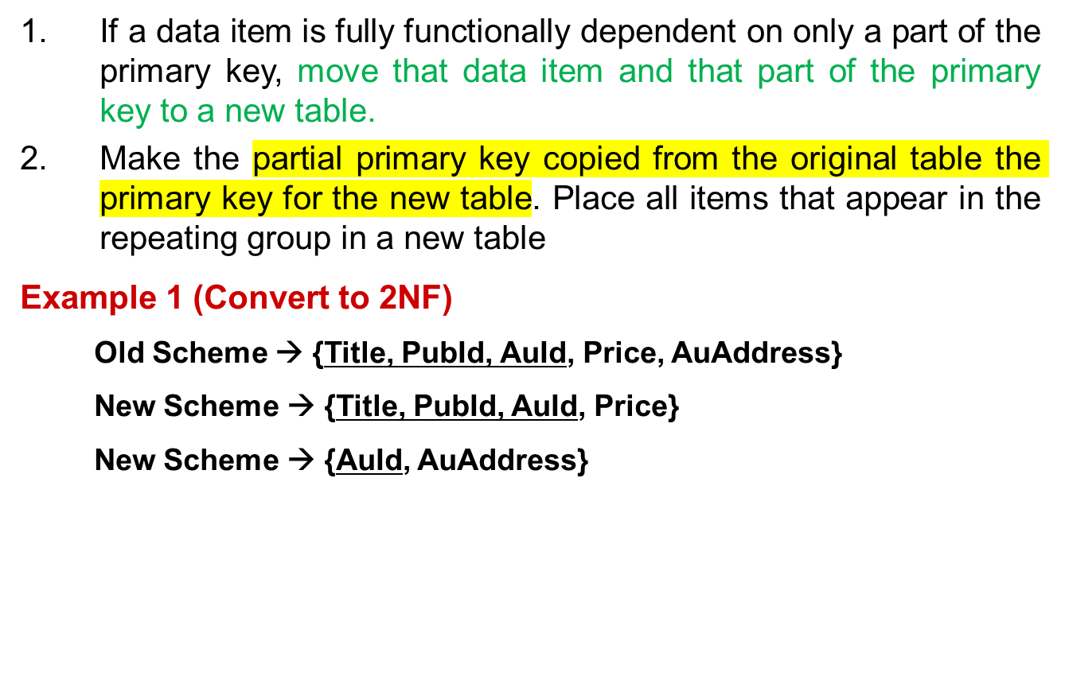
2NF - Decomposition
Notes:
If there is a table with columns A,B,C,D with Primary Key (A,B) & D is dependant on A (alone) then to be 2NF, you should reduce (split) tables as:
Table with columns A,D with Primary Key (A)
Table with columns A,B,C with Primary Key (A,B)

Slide 14
2NF - Decomposition
Example 2 (Convert to 2NF)
  Old Scheme → {Studio, Movie, Budget, City}
  New Scheme → {Movie, Studio, Budget}
  New Scheme → {Studio, City}
Example 3 (Convert to 2NF)
  Old Scheme → {City, Street, HouseNumber, HouseColor, CityPopulation}
  New Scheme → {City, Street, HouseNumber, HouseColor}
  New Scheme → {City, CityPopulation}

Slide 15
Third Normal Form (3NF)
This form dictates that all non-key attributes of a table must be functionally dependent only and only on the primary key i.e. there can be no interdependencies among non-key attributes.
→ The nonkey attributes should be independent of each other!
For a table to be in 3NF, there are two requirements
  The table should be second normal form
  No attribute is transitively dependent on the primary key
Example (Not in 3NF)
Scheme → {Title, PubID, PageCount, Price }
  Key → {Title, PubId}
  {Title, PubId} → {PageCount}
  {PageCount} → {Price}
  Both Price and PageCount depend on a key hence 2NF
  Transitively {Title, PubID} →{PageCount} → {Price} hence not in 3NF
Notes:
In the Book Schema Third Normal Form is violated since a non-key field is dependent on another non-key field and is transitively dependent on the primary key.

Slide 16
Third Normal Form (3NF)
Example 2 (Not in 3NF)
Scheme → {Studio, StudioCity, CityTemp}
  Primary Key → {Studio}
  {Studio} → {StudioCity}
  {StudioCity} → {CityTemp}
  {Studio} → {CityTemp}
  Both StudioCity and CityTemp depend on the entire key hence 2NF
  CityTemp transitively depends on Studio hence violates 3NF
Example 3 (Not in 3NF)
Scheme → {BuildingID, Contractor, Fee}
  Primary Key → {BuildingID}
  {BuildingID} → {Contractor}
  {Contractor} → {Fee}
  {BuildingID} → {Fee}
  Fee transitively depends on the BuildingID
  Both Contractor and Fee depend on the entire key hence 2NF
BuildingID
Contractor
Fee
100
Randolph
1200
150
Ingersoll
1100
200
Randolph
1200
250
Pitkin
1100
300
Randolph
1200
Notes:
Let us consider the problems with the movie studio database:
Redundancy – City Population is repeated many times
Insertion anomaly – Whenever we add a new record we have to add unnecessary information. We can not add record until we know information about the city population
Deletion anomaly – Whenever we delete a record, useful information is deleted.
Update anomaly – The City Population needs to be updated in more than one location if it changes.

Slide 17
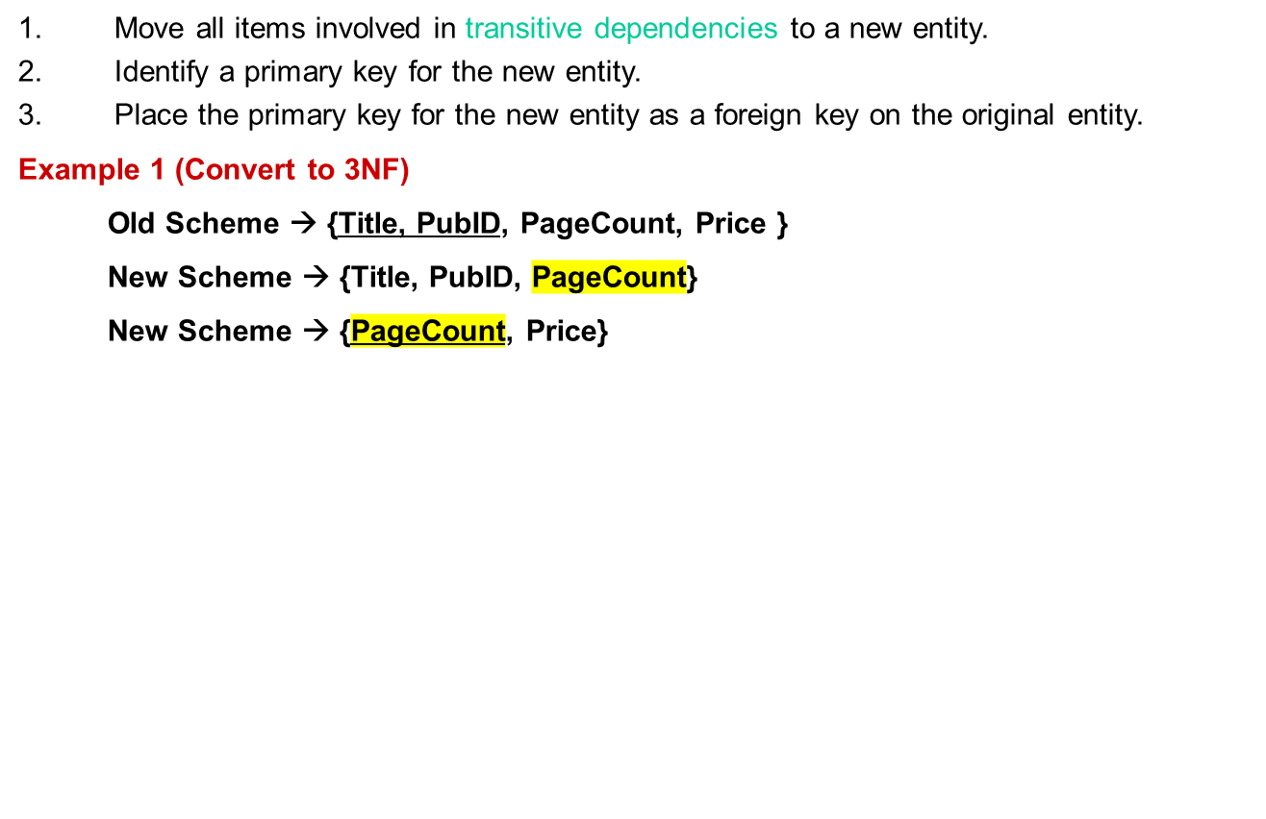
3NF - Decomposition
Example (Not in 3NF)
Scheme → {Title, PubID, PageCount, Price }
  Key → {Title, PubId}
  {Title, PubId} → {PageCount}
  {PageCount} → {Price}
  Both Price and PageCount depend on a key hence 2NF
  Transitively {Title, PubID} → {Price} hence not in 3NF
Notes:
If there is a table with columns A,B,C with Primary Key (A) and C is dependant on B (B → C) then to be 3NF, the tables become
Table with columns B,C with Primary Key (B)
Table with fields A,B with Primary Key ( A), and Foreign Key (B)

Slide 18
3NF - Decomposition
Example 2 (Convert to 3NF)
  Old Scheme → {Studio, StudioCity, CityTemp}
  New Scheme → {Studio, StudioCity}
  New Scheme → {StudioCity, CityTemp}
Example 3 (Convert to 3NF)
  Old Scheme → {BuildingID, Contractor, Fee}
  New Scheme → {BuildingID, Contractor}
  New Scheme → {Contractor, Fee}
BuildingID
Contractor
Contractor
Fee
100
Randolph
Randolph
1200
150
Ingersoll
Ingersoll
1100
200
Randolph
Pitkin
1100
250
Pitkin
300
Randolph

Slide 19
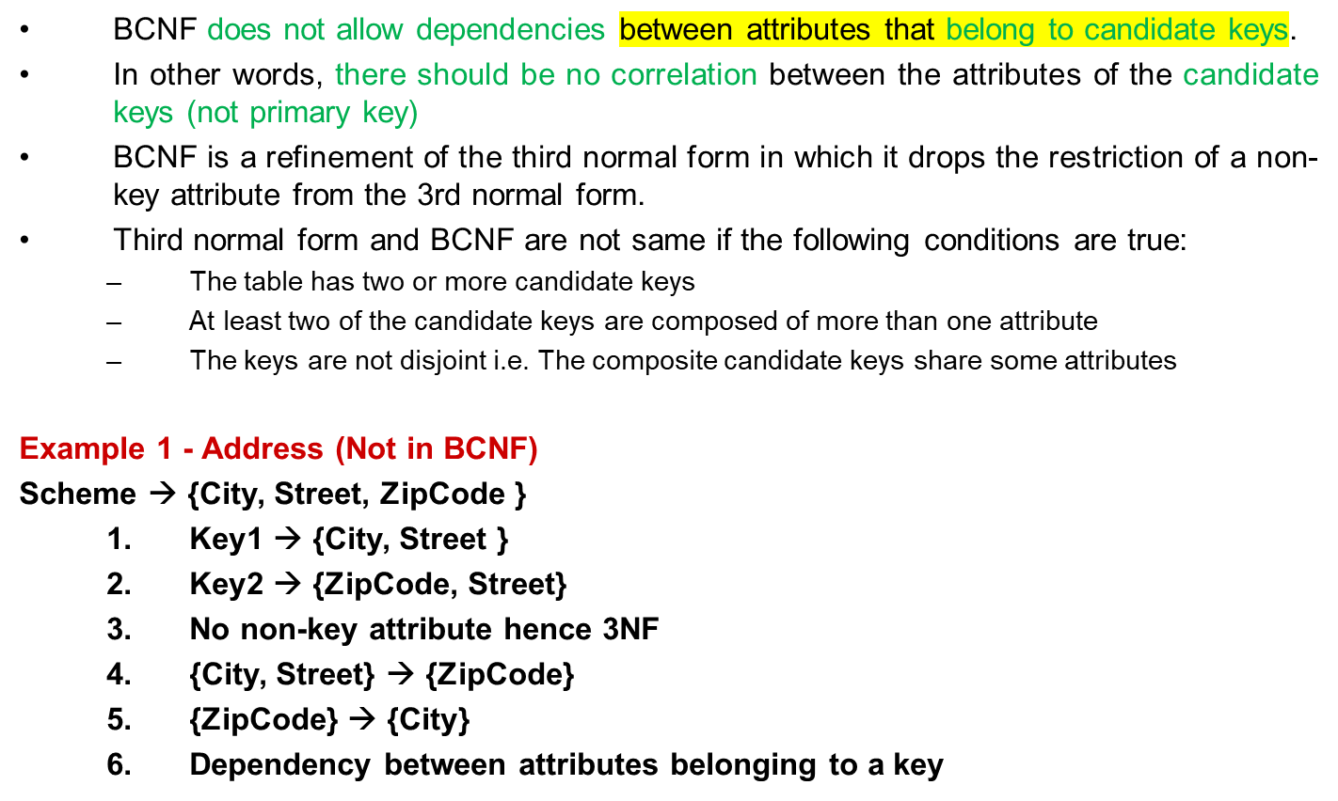
Boyce-Codd Normal Form (BCNF)
Notes:
The second and third normal forms assume that all attributes not part of the candidate keys depend on the candidate keys but does not deal with dependencies within the keys. BCNF deals with such dependencies.
Under third normal form all non-key columns must be functionally dependent on a candidate key. Under BCNF, even columns that are part of a candidate key must be dependent on another candidate key, if they have a dependency at all.
For most tables third normal form and BCNF are the same. Third normal form does not cover some specific cases for which BCNF was created. Third normal form and BCNF are not same if the following conditions are true:
The table has two or more candidate keys
At least two of the candidate keys are composed of more than one attribute
The keys are not disjoint i.e. The composite candidate keys share some attributes

Slide 20
BCNF - Decomposition
Place the two candidate primary keys in separate entities
Place each of the remaining data items in one of the resulting entities according to its dependency on the primary key.
Example 1 (Convert to BCNF)
  Old Scheme → {City, Street, ZipCode }
  New Scheme1 → {ZipCode, Street}
  New Scheme2 → {City, Street}
  Alternate New Scheme1 → {ZipCode, Street }
  Alternate New Scheme2 → {ZipCode, City}
Example 1 - Address (Not in BCNF)
Scheme → {City, Street, ZipCode }
  Key1 → {City, Street }
  Key2 → {ZipCode, Street}
  No non-key attribute hence 3NF
  {City, Street} → {ZipCode}
  {ZipCode} → {City}
  Dependency between attributes belonging to a key
Notes:
If there is a table with columns A,B,C with Primary Key (A) and C is dependant on B (B → C) then to be 3NF, the tables become
Table with columns B,C with Primary Key (B)
Table with fields A,B with Primary Key ( A), and Foreign Key (B)

Slide 21
Decomposition – Loss of Information
If decomposition does not cause any loss of information it is called a lossless decomposition.
If a decomposition does not cause any dependencies to be lost it is called a dependency-preserving decomposition.
Any table scheme can be decomposed in a lossless way into a collection of smaller schemas that are in BCNF form. However the dependency preservation is not guaranteed.
Any table can be decomposed in a lossless way into 3rd normal form that also preserves the dependencies.
  3NF may be better than BCNF in some cases
Use your own judgment when decomposing schemas

Slide 22
Fourth Normal Form (4NF)
Fourth normal form eliminates independent many-to-one relationships between columns.
To be in Fourth Normal Form,
  a relation must first be in Boyce-Codd Normal Form.
  a given relation may not contain more than one multi-valued attribute.
Example (Not in 4NF)
  Scheme → {MovieName, ScreeningCity, Genre)
  Primary Key: {MovieName, ScreeningCity, Genre)
  All columns are a part of the only candidate key, hence BCNF
  Many Movies can have the same Genre
  Many Cities can have the same movie
  Violates 4NF
Movie
ScreeningCity
Genre
Hard Code
Los Angles
Comedy
Hard Code
New York
Comedy
Bill Durham
Santa Cruz
Drama
Bill Durham
Durham
Drama
The Code Warrier
New York
Horror

Slide 23
Fourth Normal Form (4NF)
Example 2 (Not in 4NF)
Scheme → {Manager, Child, Employee}
  Primary Key → {Manager, Child, Employee}
  Each manager can have more than one child
  Each manager can supervise more than one employee
  4NF Violated
Example 3 (Not in 4NF)
Scheme → {Employee, Skill, ForeignLanguage}
  Primary Key → {Employee, Skill, Language }
  Each employee can speak multiple languages
  Each employee can have multiple skills
  Thus violates 4NF
Manager
Child
Employee
Jim
Beth
Alice
Mary
Bob
Jane
Mary
NULL
Adam
Employee
Skill
Language
1234
Cooking
French
1234
Cooking
German
1453
Carpentry
Spanish
1453
Cooking
Spanish
2345
Cooking
Spanish
Notes:
These cause update, addition and deletion anomalies.
Insertion anomaly is that entity integrity would be violated if you tried to add a new employee who did not speak a foreign language.
Update anomalies would occur if you tried to change Cooking to Chef.

Slide 24
4NF - Decomposition
Move the two multi-valued relations to separate tables
Identify a primary key for each of the new entity.
Example 1 (Convert to 3NF)
  Old Scheme → {MovieName, ScreeningCity, Genre}
  New Scheme → {MovieName, ScreeningCity}
  New Scheme → {MovieName, Genre}
Movie
Genre
Movie
ScreeningCity
Hard Code
Comedy
Hard Code
Los Angles
Bill Durham
Drama
Hard Code
New York
The Code Warrier
Horror
Bill Durham
Santa Cruz
Bill Durham
Durham
The Code Warrier
New York

Slide 25
4NF - Decomposition
Example 2 (Convert to 4NF)
  Old Scheme → {Manager, Child, Employee}
  New Scheme → {Manager, Child}
  New Scheme → {Manager, Employee}
Example 3 (Convert to 4NF)
  Old Scheme → {Employee, Skill, ForeignLanguage}
  New Scheme → {Employee, Skill}
  New Scheme → {Employee, ForeignLanguage}
Manager
Child
Manager
Employee
Jim
Beth
Jim
Alice
Mary
Bob
Mary
Jane
Mary
Adam
Employee
Skill
Employee
Language
1234
Cooking
1234
French
1453
Carpentry
1234
German
1453
Cooking
1453
Spanish
2345
Cooking
2345
Spanish

Slide 26
Fifth Normal Form (5NF)
Fifth normal form is satisfied when all tables are broken into as many tables as possible in order to avoid redundancy. Once it is in fifth normal form it cannot be broken into smaller relations without changing the facts or the meaning.

Slide 27
Domain Key Normal Form (DKNF)
The relation is in DKNF when there can be no insertion or deletion anomalies in the database.

Slide 28
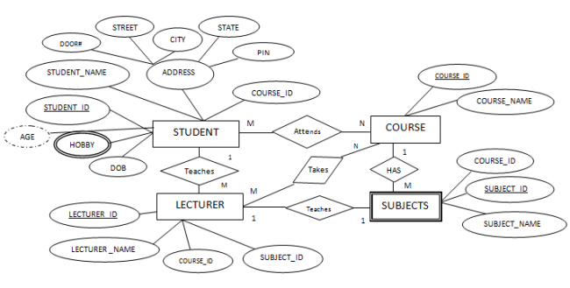
Convert ER Diagram into Tables/database
The basic rule for converting the ER diagrams into tables is:
Convert all the Entities in the diagram to tables.
All the entities represented in the rectangular box in the ER diagram become independent tables in the database. In the above diagram, STUDENT, COURSE, LECTURER and SUBJECTS forms individual tables.
All single valued attributes of an entity is converted to a column of the table
All the attributes, whose value at any instance of time is unique, are considered as columns of that table. In the STUDENT Entity, STUDENT_ID, STUDENT_NAME form the columns of STUDENT table. Similarly, LECTURER_ID, LECTURER_NAME form the columns of LECTURER table. And so on.

Slide 29
Convert ER Diagram into Tables
Key attribute in the ER diagram becomes the Primary key of the table.
In diagram above, STUDENT_ID, LECTURER_ID, COURSE_ID and SUB_ID are the key attributes of the entities. Hence we consider them as the primary keys of respective table.
Declare the foreign key column, if applicable.
In the diagram, attribute COURSE_ID in the STUDENT entity is from COURSE entity. Hence add COURSE_ID in the STUDENT table and assign it foreign key constraint. COURSE_ID and SUBJECT_ID in LECTURER table forms the foreign key column. Hence by declaring the foreign key constraints, mapping between the tables are established.

Slide 30
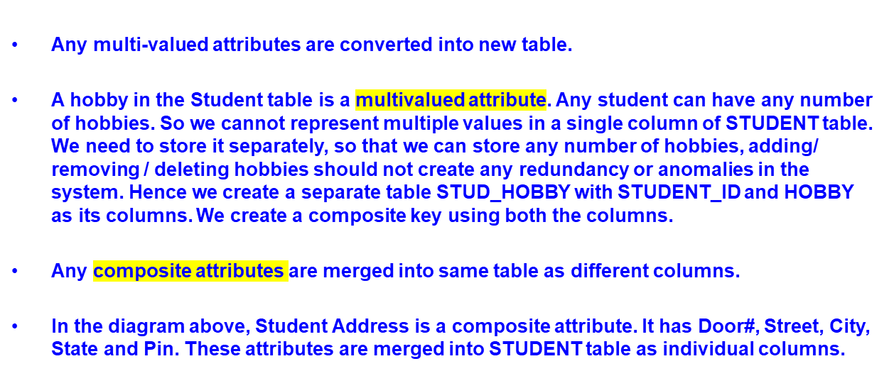
Convert ER Diagram into Tables

Slide 31
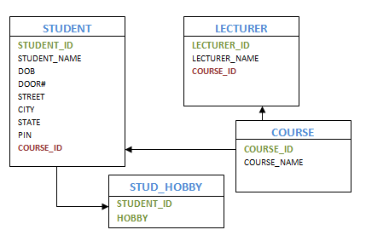
Convert ER Diagram into Tables
One can ignore derived attribute, since it can be calculated at any time.
In the STUDENT table, Age can be derived at any point of time by calculating the difference between DateOfBirth and current date. Hence we need not create a column for this attribute. It reduces the duplicity in the database.
These are the very basic rules of converting ER diagram into tables and columns, and assigning the mapping between the tables. Table structure at this would be as below:

Slide 32
Special Cases
Converting Weak Entity
Weak entity is also represented as table. All the attributes of the weak entity forms the column of the table. But the key attribute represented in the diagram cannot form the primary key of this table. We have to add a foreign key column, which would be the primary key column of its strong entity. This foreign key column along with its key attribute column forms the primary key of the table.
Notes:
https://www.tutorialcup.com/dbms/er-model-into-tables.htm

Slide 33
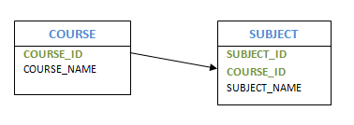
Special Cases
In our example above, SUBJECTS is the weak entity. Hence, we create a table for it. Its attributes SUBJECT_ID and SUBJECT_NAME forms the column of this table. Although SUBJECT_ID is represented as key attribute in the diagram, it cannot be considered as primary key. In order to add primary key to the column, we have to find the foreign key first. COURSE is the strong entity related to SUBJECT. Hence the primary key COURSE_ID of COURSE is added to SUBJECT table as foreign key. Now we can create a composite primary key out of COURSE_ID and SUBJECT_ID.

Slide 34
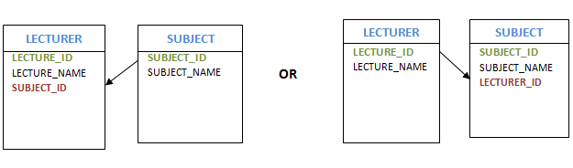
Special Cases
Representing 1:1 relationship
Imagine SUBJECT is not a weak entity, and we have LECTURER teaches SUBJECT relation. It is a 1:1 relation. i.e.; one lecturer teaches only one subject. We can represent this case in two ways
1. Create table for both LECTURER and SUBJECT. Add the primary key of LECTURER in SUBJECT table as foreign key. It implies the lecturer name for that particular subject.
2. Create table for both LECTURER and SUBJECT. Add the primary key of SUBJECT in LECTURER table as foreign key. It implies the subject taught by the lecturer.
In both the case, meaning is same. Foreign key column can be added in either of the table, depending on the developer’s choice.

Slide 35
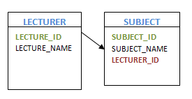
Special Cases
Representing 1:N relationship
Consider SUBJECT and LECTURER relation, where each Lecturer teaches multiple subjects. This is a 1: N relation. In this case, primary key of LECTURER table is added to the SUBJECT table. i.e.; the primary key at 1 cardinality entity is added as foreign key to N cardinality entity

Slide 36
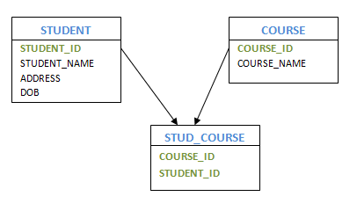
Special Cases
Representing M:N relationship
Consider the example, multiple students enrolled for multiple courses, which is M:N relation. In this case, we create STUDENT and COURSE tables for the entities. Create one more table for the relation ‘Enrolment’ and name it as STUD_COURSE. Add the primary keys of COURSE and STUDENT into it, which forms the composite primary key of the new table.
That is, in this case both the participating entities are converted into tables, and a new table is created for the relation between them. Primary keys of entity tables are added into new table to form the composite primary key. We can add any additional columns, if present as attribute of the relation in ER diagram.

